Slide 1
Security & Surveillance
SMART CITY – INTERNET OF THINGS

Slide 2
Agenda
Idea
Object model
Roles
Key features
Use cases

Slide 3
Ministry
Major Entities:
Law & Enforcement Department
Transport Authority Department
Resident Authority Department
Operations Control Department
Sherriff's Agency
Vehicle Agency
Resident Administration Agency
Entry Exit Monitoring Agency
GPS Monitoring Agency
Number Plate Recognition Agency
Illegal Vehicle Monitoring Agency

Slide 4
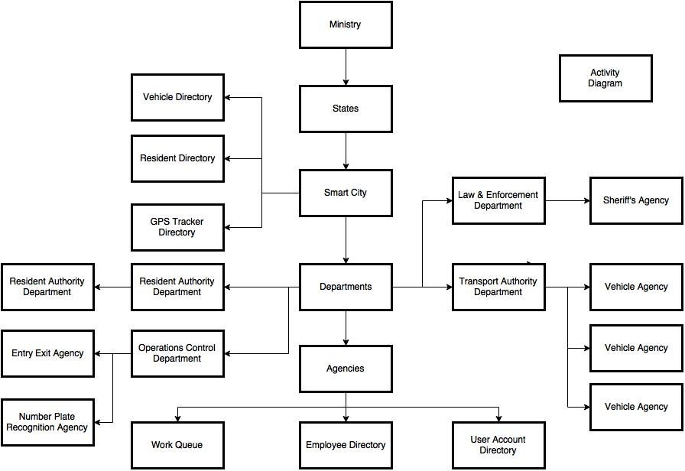
Object Model:

Slide 5
Roles:
Resident Agency Admin : Administers addition of Residents to smart city.
Vehicle Agency Admin: Registers Vehicle to the appropriate resident.
Illegal Vehicle Agency Admin: Marks any vehicle registration number as ‘Illegal’ supporting a list of restricted vehicles to Sherriff’s agency.
Entry-Exit Agency Admin: Administers entry exit junctions and associates Number Plate Recognition Devices to each junction.
Sherriff’s Agency Admin: Processes requests sent by Illegal Vehicle Agency to restrict vehicles from entering into City.
System Admin Role: Creation of new cities, states, respective departments and agencies in the application.
Department Admin Role: Creating new agencies and their employees.

Slide 6
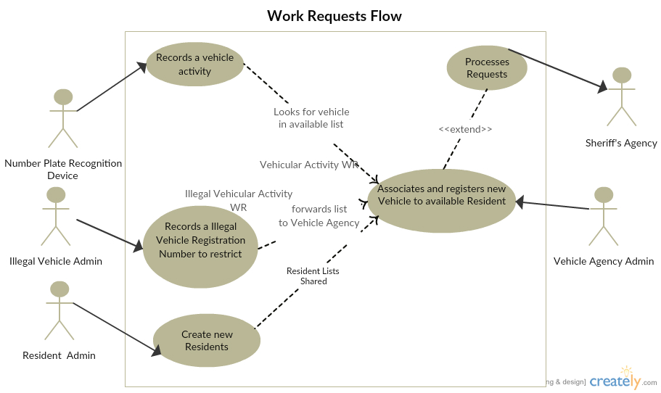
Use Case -1: Work Requests Flow

Slide 7
Key Features:
Allocate GPS Devices to registered vehicles.
Track GPS co-ordinates of each car entering the smart city.
Smart algorithm to simulate GPS data generation for each car.
Effectively used hash map for storing GPS co-ordinates of each car.
Monitoring minute-wise GPS tracking

Slide 8
References
http://beginnersbook.com/2013/12/hashmap-in-java-with-example/
https://creately.com
https://draw.io

